Slide 1
EAST AFRICAN COMMUNICATIONS ORGANISATION · CLIENT BRIEFING
Digital Transformation & Inclusion
in East Africa
A geospatial and statistical assessment of internet adoption, mobile connectivity,
and electricity access across eight East African countries, 2010–2024.
World Bank
8
2010–2024
Indicators API
East African countries
Analysis period
Group 2

Slide 2
Problem Definition
Digital technologies have reshaped education, commerce, healthcare, government services, and financial inclusion across the world. Within East Africa, however, digital access remains uneven; some countries are pulling ahead while others risk being left behind.
COUNTRIES COVERED
Burundi
Ethiopia
OBJECTIVE
Kenya
To evaluate the progress of digital transformation across East Africa and identify the countries that most require additional investment in digital infrastructure.
Rwanda
Somalia
South Sudan
CLIENT
Tanzania
East African Communications Organisation (EACO)
Regional body coordinating ICT policy and regulation across East Africa.
Uganda
EACO — Digital Transformation & Inclusion in East Africa
2

Slide 3
Research Questions
1
Which East African country has experienced the highest growth in internet users, 2010–2024?
2
How does internet penetration compare with mobile-phone subscriptions across countries?
3
Is access to electricity associated with higher internet usage?
4
Which country has the largest gap between mobile-phone ownership and internet adoption?
5
How does Kenya compare with the other East African countries in digital transformation?
6
Which three policy interventions would accelerate digital inclusion in the region?
EACO — Digital Transformation & Inclusion in East Africa
3

Slide 4
METHODOLOGY
Data Source & API Retrieval
All data retrieved directly in Python from the World Bank Indicators API (v2), for the eight East African countries in EACO's footprint, using ISO3 country codes for robustness.
Item | Value
Base URL | https://api.worldbank.org/v2
Country list endpoint | /country?format=json&per_page=300&region=SSF
Data endpoint | /country/{code}/indicator/{indicator}
Data parameters | format=json, date=2010:2024, per_page=100
Indicator code | Variable | Role
IT.NET.USER.ZS | Internet users (% of population) | Outcome
IT.CEL.SETS.P2 | Mobile subscriptions (per 100 people) | Comparison / gap
EG.ELC.ACCS.ZS | Access to electricity (% of population) | Enabling infrastructure
Retrieved 360 country-year-indicator records across 3 indicators × 8 countries × 15 years (2010–2024).
EACO — Digital Transformation & Inclusion in East Africa
4

Slide 5
METHODOLOGY
Data Quality Assessment
360
0
0
8.3%
Records retrieved
(incl. nulls)
Duplicate
(country, year, indicator) rows
Range-check violations
(<0% or >100%)
Missing: Internet Users
(worst indicator)
Indicator | % Missing | % Complete | Latest year available
Electricity Access (%) | 0.0% | 100.0% | 2024
Internet Users (%) | 8.3% | 91.7% | 2024
Mobile Subscriptions (per 100) | 4.2% | 95.8% | 2024
Outliers: 0 flagged by 1.5×IQR on any indicator; cross-country spread reflects genuine differences, not data errors. Consistency: 8 country-years show mobile subscriptions > 100 per 100 people valid, reflecting multi-SIM ownership, not retained as an error.
EACO — Digital Transformation & Inclusion in East Africa
5

Slide 6
METHODOLOGY
Cleaning & Preprocessing Decisions
1
Missing values
Rows with nulls are dropped from the analysis; each country's latest available year is used for each indicator rather than forcing 2024. World Bank/ITU data lags by 1–2 years; inventing 2024 values would fabricate evidence. The year used is reported alongside each value.
2
No interpolation
Series are analysed as reported. Interior gaps are small, and interpolation would add assumptions without changing conclusions.
3
Duplicates
Removed on (country, year, indicator), keeping the first record. Zero duplicates were found.
4
Range checks
Percentage indicators clipped to [0, 100]. Mobile subscriptions are NOT capped at 100, since values above 100 per 100 people reflect real multi-SIM ownership rather than error.
EACO — Digital Transformation & Inclusion in East Africa
6

Slide 7
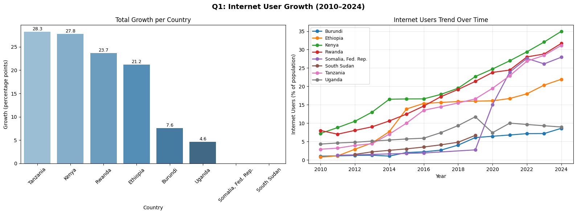
Q1 · GROWTH 2010–2024
Tanzania Leads Growth in Internet Users
+28.3 pp
Tanzania has largest absolute
growth, 2010 → 2024
Kenya: +27.8 pp
Rwanda: +23.7 pp | Ethiopia: +21.2 pp
Somalia & South Sudan lack a
complete 2010 baseline for direct
comparison.
Why this chart: a sorted bar chart answers a ranking question at a glance; the paired line chart shows the shape of change over time: steady growth for leaders vs. flat trajectories for laggards.
Statistical technique — Trend Analysis (CAGR): Tanzania shows the highest absolute growth (28.3 pp, CAGR 18.5%), while Ethiopia, starting from a near-zero base of 0.8% in 2010, shows the highest relative growth (CAGR 27.3%), reaching 21.9% by 2024.
EACO — Digital Transformation & Inclusion in East Africa
7

Slide 8
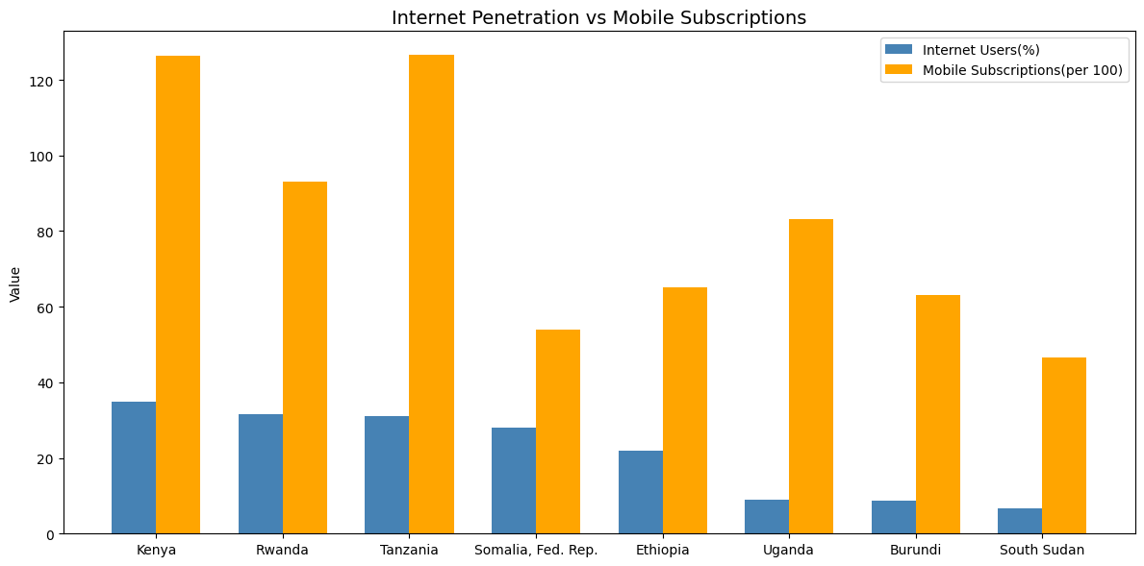
Q2 · PENETRATION COMPARISON
Mobile Reach Far Outpaces Internet Use — Everywhere
KEY PATTERN
In every one of the 8 countries, mobile phone subscriptions exceed internet users(%) by a wide margin. Kenya and Tanzania both post ~126 mobile subscriptions per 100 people, yet internet use sits at 35% and 31%, respectively.
Networks already reach far more people than actively use the internet; the binding constraint is on the demand side (affordability, devices, digital skills), not network coverage.
Why this chart: grouped bars compare two related, same-scale measures (per 100 population) side by side per country; consistent colours and a shared axis make the comparison direct.
EACO — Digital Transformation & Inclusion in East Africa
8

Slide 9
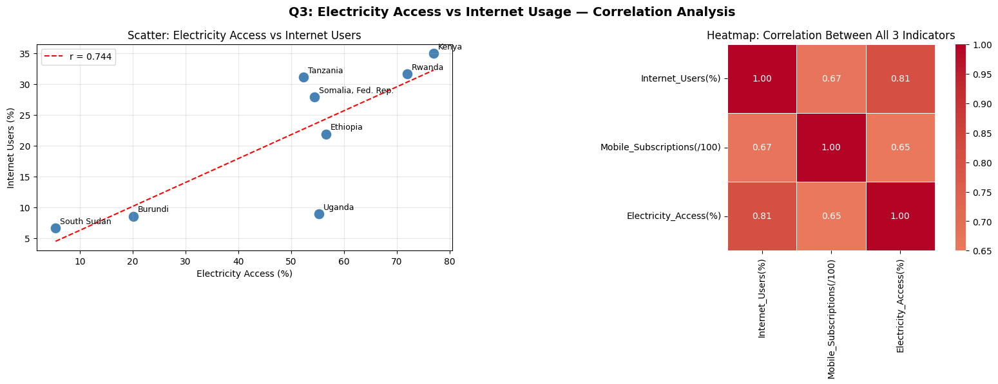
Q3 · ELECTRICITY & CONNECTIVITY
Electricity Access Is a Strong Predictor of Internet Use
r = 0.744
Pooled panel
Pearson r
(n=110, p<0.001)
ρ = 0.683
Spearman rank
(p<0.001)
r = 0.739
Latest-year
cross-section (n=7)
Why these charts: the scatter plot shows the relationship between two continuous variables with a fitted regression line; the heatmap encodes strength and direction across all three indicators at once, showing mobile subscriptions also correlate strongly with both.
Countries with greater electricity access consistently show higher internet use; power is a foundational requirement for digital transformation. Without it, devices cannot be charged or connected.
EACO — Digital Transformation & Inclusion in East Africa
9

Slide 10
Q3 · STATISTICAL TECHNIQUE
OLS Regression: Electricity Predicts Internet Use
Does electricity access predict internet use after controlling for mobile subscriptions? Clustered standard errors account for repeated observations per country (panel data, n=107).
Predictor | Coefficient | Std. Error | z | P>|z|
Const | -4.988 | 1.829 | -2.727 | 0.006
Electricity access (%) | 0.174 | 0.057 | 3.072 | 0.002
Mobile subscriptions | 0.183 | 0.045 | 4.083 | < 0.001
R² = 0.715
71.5% of variation in internet use is explained by electricity access + mobile subscriptions
INTERPRETATION
Both predictors are statistically significant (p < 0.01). Holding mobile subscriptions constant, a 10-point increase in electricity access is associated with roughly a 1.7-point increase in internet usage. Electricity access is not merely correlated with internet use; it remains a significant, independent predictor even after accounting for how widely mobile networks already reach.
EACO — Digital Transformation & Inclusion in East Africa
10

Slide 11
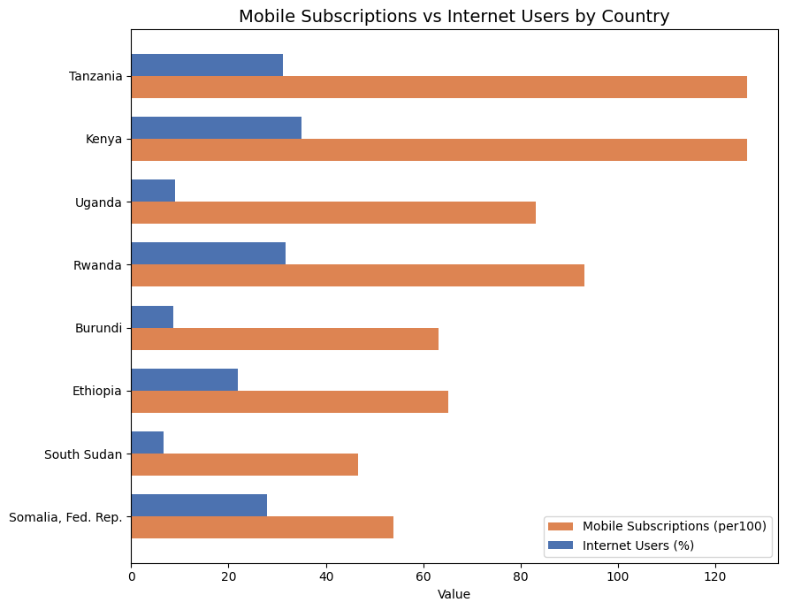
Q4 · ADOPTION GAP
Tanzania Has the Widest Mobile–Internet Gap
95.4 points
Tanzania's gap: 126.6 mobile subscriptions per 100 people vs. only 31.2% internet users
Kenya
91.5 pts
Uganda
74.2 pts
Rwanda
61.5 pts
Burundi
54.6 pts
The gap is smallest in Somalia (26.0 pts) and South Sudan (40.0 pts), but only because both mobile and internet uptake are low there, not because adoption is balanced.
EACO — Digital Transformation & Inclusion in East Africa
11

Slide 12
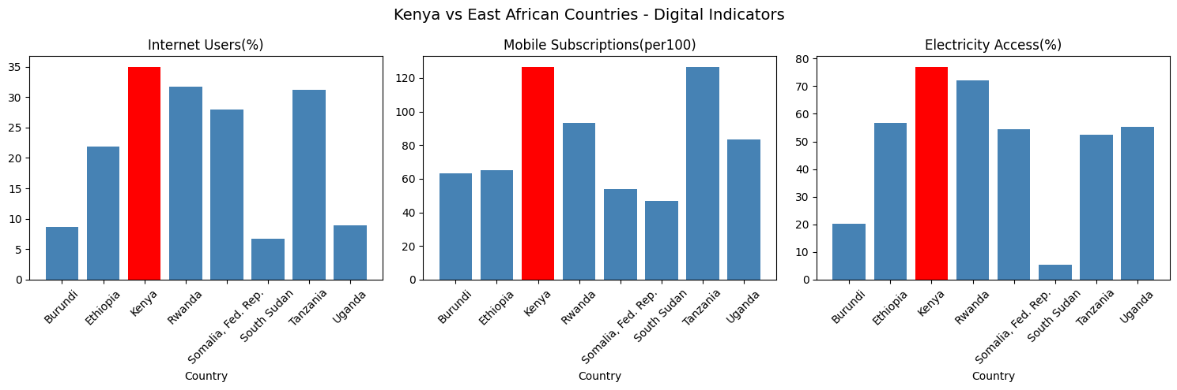
Q5 · KENYA IN CONTEXT
Kenya Leads the Region on Every Core Indicator
#1 of 8
Internet users (34.98%)
#2 of 8
Mobile subscriptions (126.48 / 100)
#1 of 8
Electricity access (77.0%)
Why this chart: small multiples compare Kenya against peers across three dimensions without overloading a single axis; highlighting Kenya in red applies pre-attentive visual emphasis.
Kenya is the region's clear digital leader, ranking first in internet penetration and electricity access, and second only to Tanzania in mobile subscriptions. This reflects sustained investment in ICT infrastructure, mobile money (M-Pesa), and digital government services, a reference model for regional catch-up strategies.
EACO — Digital Transformation & Inclusion in East Africa
12

Slide 13
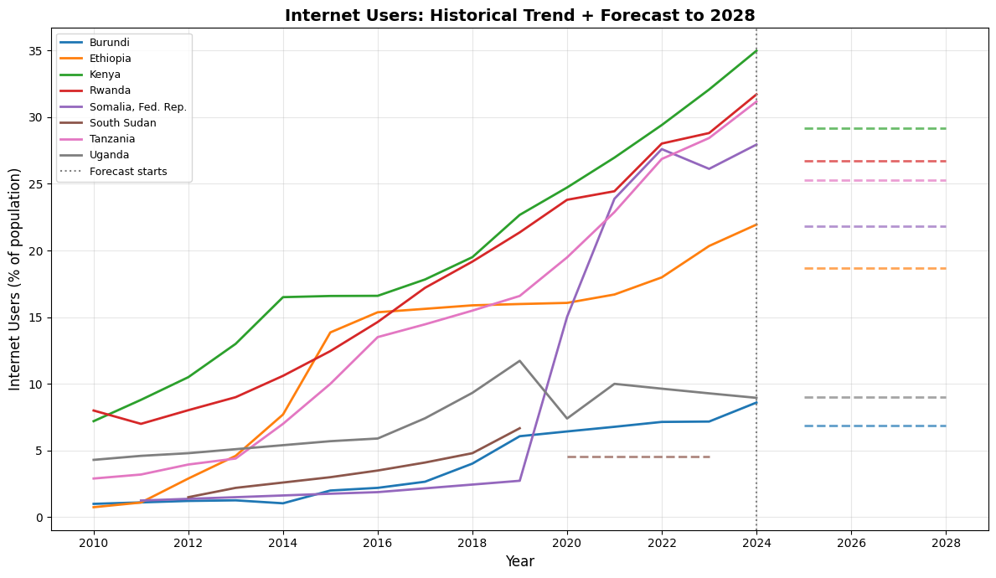
Q6 · FORECASTING TO 2028
On Current Trends, the Region's Digital Divide Widens
LEADERS BY 2028
Kenya · Rwanda · Somalia
Tanzania
≈ 40%+ internet users forecast
LAGGARDS BY 2028
Burundi · South Sudan
Uganda
remain below 15% internet users forecast without intervention, the gap to leaders widens further.
Statistical technique: Forecasting (Holt exponential smoothing): each country’s trend is projected to 2028. The vertical marker separates observed 2010–2024 data from the projection, showing that without intervention, the divide inside East Africa widens rather than narrows.
EACO — Digital Transformation & Inclusion in East Africa
13

Slide 14
RECOMMENDATIONS FOR EACO
Three Evidence-Based Policy Interventions
01
Coordinate electrification with connectivity investment
High correlation between electricity access and internet use is r = 0.744 (p < 0.001, n = 110); the OLS regression confirms electricity remains a significant predictor after controlling for mobile subscriptions. EACO should advocate joint energy–connectivity planning: fibre along grid extensions, solar-powered base stations off-grid.
02
Review sector-specific taxes on data and devices
In every country, mobile subscriptions far exceed internet use; the largest gap is Tanzania at 95.4 points. Networks already reach far more people than use the internet, so the binding constraint is demand-side. Recommended: review sector-specific taxes on data and devices, and zero-rate essential education and health services.
03
Target Universal Service Funds at the diverging countries
Holt forecasts show the region diverging by 2028: leaders (Kenya, Rwanda, Somalia, Tanzania) approach 40%+, while laggards (Burundi, South Sudan, Uganda) remain below 15%. Recommended: prioritise USF disbursement and infrastructure-sharing mandates in the lagging countries before the gap widens further.
EACO — Digital Transformation & Inclusion in East Africa
14

Slide 15
EXECUTIVE SUMMARY
Growth leader
Mobile > internet, everywhere
Tanzania grew fastest in absolute terms (+28.3 pp); Ethiopia grew fastest relatively (27.3% CAGR) from a near-zero base.
Mobile reach outstrips internet use in all 8 countries; demand-side barriers, not coverage, are the constraint.
Electricity matters
Widest gap
Electricity access predicts internet use (r = 0.744, R² = 0.715) even after controlling for mobile penetration.
Tanzania has the largest mobile–internet adoption gap (95.4 points), followed by Kenya (91.5 points).
Kenya leads
Divide widening
Kenya ranks #1 in internet use and electricity access, and #2 in mobile subscriptions — a regional benchmark.
Absent intervention, Holt forecasts show leaders approaching 40%+ internet use by 2028 while laggards stay below 15%.
EACO — Digital Transformation & Inclusion in East Africa
15

